Slide 1
Enagás, GRTgaz, REN and TIGF
21st SG meeting
19th February 2014

Slide 2
II.1. 2014 OSP ST between France and Spain

Slide 3
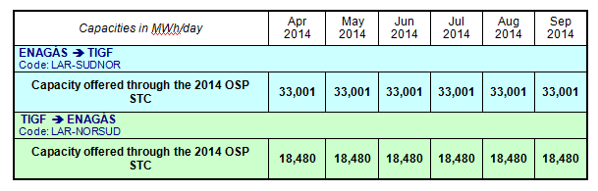
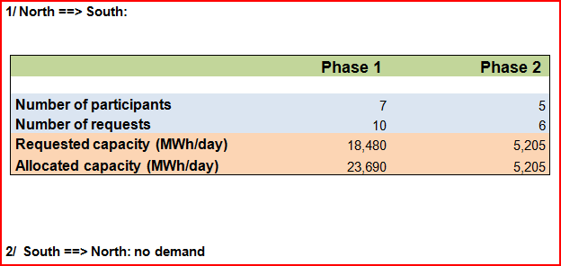
1. OSP 2014
  Offered capacities
  Results

Slide 4
II.3.1. Using PRISMA: training session, shipper’s registration

Slide 5
1. PRISMA Meeting Assistants in Madrid
PRISMA Platform
  2 Assistants
Shippers
  29 Assitants
  16 Shippers
TSO´s
  3 TIGF Assistants
  6 ENAGÁS Assistants
  3 REN Assistants
Regulator
    1 CNMC Assistant
Total Assistants: 45 people

Slide 6
2. PRISMA Meeting Agenda in Madrid
About PRISMA
  General information about the platform.
  Number of users and shippers in the platform.
  Number of auctions that have taken place.
  Capacity quantities allocated.
Registration in PRISMA
  Need of EIC code for each company.
  Register a new shipper.
  Register a new user.
  Register to a new TSO and check registration status.

Slide 7
2. PRISMA Meeting Agenda in Madrid
My PRISMA
    Shipper profile in the platform.
    User profile in the platform.
Network points
  Network point characteristics.
  Auctions and Products at network points.
Auctions
  General Principles.
  Ascending Clock Auction Process.
  Uniform Auction Process.
  Bundled Auctions.

Slide 8
3. Enagás shipper´s registration
Enagás is waiting for the approval of the contract “Contrato Marco para el Acceso al Sistema de Transporte y Distribución de Enagás Transporte S.A.U. mediante Conexiones Internacionales por Gasoducto con Europa” by the spanish regulator. Then, Shippers will have to sign this Standard Contract with Enagás in order to participate in the auctions. Any shipper or user would be approved until these two requirements would be completed.
Shippers Registred with Enagás
  19 Shippers registred:
Users Registred with Enagás
  37 Users registred.
  18 registred as Shipper in Spanish Market
  1 not registred as a Shipper in Spanish Market

Slide 9
4. TIGF shipper´s registration
Shippers Registered with TIGF
  24 shippers registered
Users Registered with TIGF
  51 users registered
Confirmed due to valid contract with TIGF and correct EIC

Slide 10
5. PRISMA training session in Lisbon
    REN held a PRISMA Training Session on 15th January in Bucelas, for the Portuguese Shippers
    5 Portuguese shippers assisted Madrid PRISMA Training Session
    The Agenda was the same as the one that took place in Madrid
    Meeting Assistants
PRISMA Platform
  2 Assistants
Shippers
  17 Assistants
  5 Shippers
TSO´s
  6 REN Assistants
total of 25 assistants

Slide 11
II.3.2. Auction details for yearly products

Slide 12
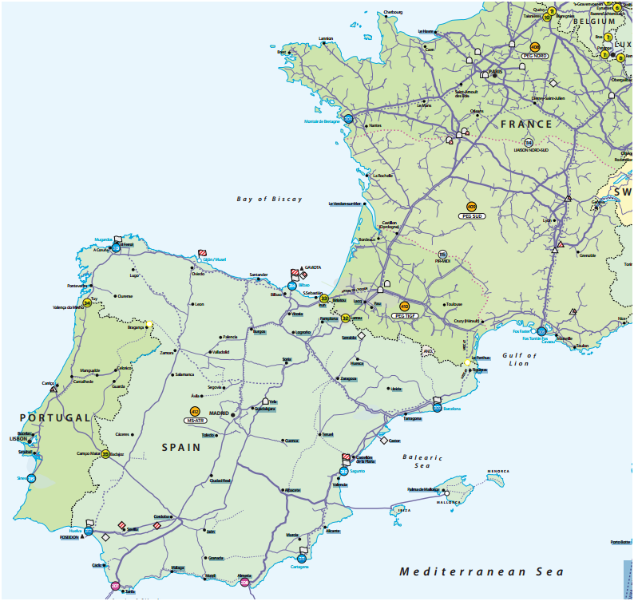
1. VIP
From 1 October 2014 all existing contracts at the physical interconnection points will be transferred into the VIPs.
VIP PIRINEOS
VIP IBERICO

Slide 13


2. 2014 auctions
 |  | VIP IBERICO | VIP PIRINEOS
Annual yearly capacity auctions | Bundled
 | Unbundled
Annual quarterly capacity auctions | Bundled
 | Unbundled
Rolling monthly capacity auctions | Bundled
 | Unbundled
Rolling day ahead capacity auctions | Bundled
 | Unbundled
1
1
1
1
2
2
2
2
2
2
3
3
4
¹ Yearly products at VIP PIRINEOS will be offered for the next 15 gas years, whereas yearly products at VIP IBERICO will only be offered for the next gas year.
² There is not a specific amount of capacity reserved for these auctions; these auctions will be carried out if not all the capacity offered in the previous auctions has been allocated.
³ Day ahead capacity will be offered under FCFS. For the day ahead bundled capacity Enagás and REN have put in place a coordinated procedure for the allocation of capacities.
⁴ Day ahead capacity at VIP PIRINEOS will only be offered in an unbundled way.

Slide 14
3. Firm and interruptible capacity
All products will be firm unless otherwise stated.
Once the auction for the corresponding firm bundled and unbundled product has finished, each TSO will decide whether to offer the corresponding interruptible product in a second slot.
Interruptible products will only be offered if the 98% of the corresponding firm technical capacity has previously been allocated.
For the next gas year, only day ahead capacity will be offered as an interruptible product, and only as long as the above condition is met.
On the French side, interruptible products could be offered as well on monthly and quarterly maturities.

Slide 15
4. Auction algorithms
Ascending clock auction algorithm
For annual yearly, annual quarterly and rolling monthly capacity auctions, an ascending clock algorithm with multiple bidding rounds shall be applied.
The ascending clock auction algorithm to be applied is described in Article 17 of the CAM NC.
Uniform-Price auction algorithm
For rolling day-ahead capacity auctions a uniform-price auction algorithm with a single bidding round shall be applied.
The uniform-price auction algorithm to be applied is described in Article 18 of the CAM NC.

Slide 16
5. Price steps
Auction Capacity Prices at VIP IBERICO
Reserve prices and auction price steps | REN Entry | ENAGÁS Exit | ENAGÁS Entry | REN Exit
Regulated price of tariff | 350.899 | 579.227 | 313.235 | 0.000
Reserve price for the bundled product | 930.13 |  | 313.24
Large price step (5%) | 17.545 | 28.960 | 15.660 | 0.000
 | 46.51 |  | 15.66
Small price step (1%) | 3.509 | 5.792 | 3.132 | 0.000
 | 9.30 |  | 3.13
All prices referred in [c€ / kWh / h / y] at 25ºC

Slide 17
5. Price steps
Auction Capacity Prices at VIP PIRINEOS
Reserve prices and auction price steps | TIGF Entry | ENAGÁS Exit | ENAGÁS Entry | TIGF Exit
Regulated price of tariff | 273.397 | 579.227 | 313.235 | 1,065.676
Reserve price for the bundled product | 852.62 |  | 1,378.91
Large price step (5%) | 13.670 | 28.960 | 15.660 | 53.285
 | 42.63 |  | 68.95
Small price step (1%) | 2.734 | 5.792 | 3.132 | 10.657
 | 8.53 |  | 13.79
All prices referred in [c€ / kWh / h / y] at 25ºC

Slide 18
6. Capacity to be offered on GRTgaz North-South link
As per Art. 2 of CAM NC, CRE has decided to cap the bids of shippers by 1/5th of the total available capacity as from the 2nd round of the ascending auctions (CRE decision the 17th October 2013 relating to North-South capacity allocations from 1st April 2014).
40 GWh/d (firm capacity) and 23 GWh/d (interruptible capacity) have been set aside for gas-intensive consumers (Open subscription period with prorata allocation made on 29 & 30th January 2013).
North-South capacities to be auctioned on 3rd March: 100% of the available capacity from 01/10/2014 to 30/09/2015 (gas year 2014/15), 50% for the gas year 2015/16, 25% for the gas year 2016/17 and 25% for the gas year 2017/18.

Slide 19

7. Booking platform
All auctions will be carried out at Prisma booking platform:
https://primary.prisma-capacity.eu/

Slide 20
8. Requirements to participate
In order to participate in an auction, Shippers and eligible customers licensed in France, Portugal and Spain (“Shippers”) shall be registered at PRISMA booking platform.
The requirements for registration are established in the PRISMA General Terms and Conditions (currently under revision, so new version of GTCs is expected as from 1st January 2014).
In order to participate in any auction Shippers must be registered on PRISMA with each TSO since different conditions can apply. The registration process consists of two steps which are both executed on the platform:
    Registration to use the platform
    Registration to conclude bookings and to participate in auctions

Slide 21
8. Requirements to participate
Shipper’s registration process is detailed in the figure below. Further information will be provided by PRISMA and TSOs.

Slide 22
9. Requirements on the French side
In order to be able to participate in auctions Shippers must be registered as licensed Shippers in the French system. The requirements and procedure to get the license are detailed by the DGEC at the following link:
http://www.developpement-durable.gouv.fr/Liste-des-fournisseurs-autorises.html
Then, Shippers will have to sign the Transport Contract with TIGF in advance in order to participate to the auctions.
Capacity allocated to a Shipper at PRISMA booking platform will be automatically introduced in the Transport Contract (“Bordereau de Capacités”), thus this allocation will be binding for shippers and it will not be necessary to sign any additional document.
Once the shipper has been informed of the allocation of capacities, it will be informed of the financial guarantees associated to the contracted capacity he has to put in place in favour of TIGF. These financial guarantees are detailed in Article 8 Guarantee of Transport Contract General Terms available on TIGF web site.

Slide 23
9. Requirements on the Portuguese side (1/2)
In order to be able to participate in auctions Shippers must be registered as licensed shippers in the Portugal. The requirements and procedure to get the license are defined by the DGEG, the Governmental Office that issues the licenses at:
https://www.dgeg.pt/
Shippers must fulfil at any time all obligations arising from regulatory provisions in force regarding shipper’s statutes and necessary contracts with the System Management.
Shippers have to have signed, at least, the Transport Contract with REN-Gasodutos in order to participate in the auctions and to have a valid financial guarantee. These financial guarantees are detailed in the “Contrato de Uso da Rede Nacional de Transporte de Gás Natural”, which general terms and conditions are available at REN’s Third Party Access Platform (ATR), at:
https://www.ign.ren.pt

Slide 24
9. Requirements on the Portuguese side (2/2)
Capacity allocated to a Shipper at PRISMA booking platform will be automatically introduced in REN’s TPA platform (ATR), thus this allocation will be binding for shippers and it will not be necessary to sign any additional document.
Once the shipper has been informed of the allocation of capacities, it will also be informed of the eventual need to reinforce the financial guarantees associated with the Transport Contract signed with REN.

Slide 25
9. Requirements on the Spanish side (1/2)
In order to be able to participate in auctions Shippers must be registered as licensed Shippers in the Spanish system. The requirements and procedure to get the license are detailed by the MINETUR at the following link:
http://www.minetur.gob.es/energia/gas/Requisitos/Paginas/comercializador.aspx
Then, licensed shippers will be included in the “List of Natural Gas Shippers” (i.e. “Listado de comercializadores de gas natural”) published by CNMC according to article 80 of the Hydrocarbons Law, modified by Law 25/2009. This List is available at:
http://www.cnmc.es/es-es/energ%C3%ADa/operadoresenerg%C3%A9ticos/listadodecomercializadores.aspx
Afterwards, they will have to get in touch with Enagás in order to have access to the SL-ATR platform (i.e. IT platform to operate in the Spanish system) and to the electronic platform where access contracts are signed.
Then, Shippers will have to sign the Standard Contract with Enagás in advance in order to participate in the auctions.

Slide 26
9. Requirements on the Spanish side (2/2)
Enagás Standard Contract
Shippers will have to sign a Standard Contract.
The Standard Contract will only be signed once during the registration process to conclude bookings and to participate in auctions with Enagás at PRISMA booking platform.
The Standard Contract will be available in the following link:
http://www.enagas.es/cs/Satellite?cid=1146237952335&language=en&pagename=ENAGAS%2FPage%2FENAG_listadoComboDoble
Capacity allocated to a Shipper at PRISMA booking platform will be automatically introduce at the SL-ATR, thus this allocation will be binding for shippers and it will not be necessary to sign any additional document.
Once the shipper has been informed of the allocation of capacities, it will be informed of the financial guarantees associated to the contracted capacity he has to put in place in favour of Enagás. These financial guarantees are detailed in Royal Decree 949/2001.

Slide 27
10. 2014 Calendar
PRISMA auction calendar for 2014
This year’s capacity auctions shall take place on the following days, in accordance with the CAM NC provisions:
03/06/2014

Slide 28

11. Capacities to be offered at VIP IBERICO
Capacity to be offered in the annual yearly bundled capacity auction in both flow directions:
Capacity to be offered by REN in the annual yearly unbundled capacity auction in the Spain-Portugal flow direction:

Slide 29
11. Capacities to be offered at VIP IBERICO
Capacity to be offered in the annual quarterly bundled capacity auction in the Spain-Portugal flow direction:
Capacity to be offered in the annual quarterly bundled capacity auction in the Portugal-Spain flow direction:

Slide 30
11. Capacities to be offered at VIP PIRINEOS
Capacity to be offered in the annual yearly bundled capacity auctions
Spain → France
France → Spain
Figures are provided at 0ºC

Slide 31
11. Capacities to be offered at VIP PIRINEOS
Capacity to be offered in the annual yearly unbundled capacity auction
Spain → France
France → Spain
Figures are provided at 0ºC

Slide 32
11. Capacities to be offered at VIP PIRINEOS
Capacity to be offered in the annual quarterly bundled capacity auction
Spain → France
France → Spain
Figures are provided at 0ºC

Slide 33
V.1 Balancing and Interoperability: implementation priorities

Slide 34
1. Preliminary identification of priorities for IPs
Harmonisation priorities for 2015 of CAM, BAL & INT NC:
Balancing regimes of GRTgaz and TIGF will converge in order to be able to offer a common VTP in the south of France by 1st April 2015
Priorities for 1st November 2015:
  Gas day (according to the CAM NC)
  Nomination and re-nomination procedures at IPs (according to the BAL NC): to be specified in interconnection agreements. A synchronised entry into force for all IPs involving adjacent TSOs is recommended.
  Data exchange (according to the INT NC)
  Reference temperature (capacity and nominations) (according to the INT NC)

Slide 35
VI.1 2013 South Gas Regional Investment Plan (GRIP) (for information by TSOs)

Slide 36

South Region
Second Edition
Gas Regional Investment Plan
SGRI – 19 February 2014

Slide 37
Table of content
  Perimeter / objectives
  Content
  Planning
37

Slide 38
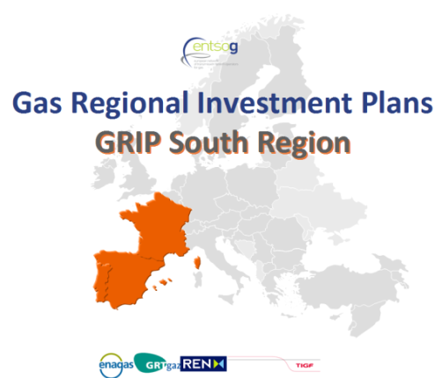

Perimeter /Objectives
3 Countries (FR, SP, PT) and 4 TSOs
Main drivers/objectives
Complementing the EU-TYNDP 2013
Feedbacks received:
  updated information / TYNDP
  More harmonization (with ENTSOG assistance)
  More communication/consultation
  More comprehensive approach on the system needs and on remedies (projects)
EU energy policy, “Trans-European energy infrastructure” (17/04/13)
“The strategic concept of the North-South Corridor in Western Europe, that is to better interconnect the Mediterranean area and thus supplies from Africa and the Northern supply Corridor with supplies from Norway and Russia.” (EC, EIP for 2020)

Slide 39
GRIP South – Demand
ANALYSES (2012) & FORECASTS
Weight/size of the South Region:
18% of EU gas demand
Focus on the Power generation sector:
Lost of competitiveness / coal
Differences / countries

Slide 40
GRIP South – Demand
ANALYSES (2012) & FORECASTS
Demand forecasts:
Updated: yearly volumes, peak days and cold period
Analyzed:
  By sectors (power gen.)
  Evolution / TYNDP

Slide 41
GRIP South – Supply
Imports (99%)
reliant on LNG (14% at EU level)
Very diversified portfolio but not homogeneous by countries
Market spreads within the region (World LNG prices …)
Additional Gas Supply (EU)
Non conventional gas →EU?
Biogas → LT
LNG
Local (by pipe) conventional reserves
Infrastructures: “EU Priority corridors”
North-South Corridor to better interconnect Portugal, Spain and supplies from Algeria to the Northern supply Corridor with supplies from Norway and Russia.

Slide 42
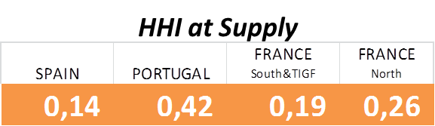
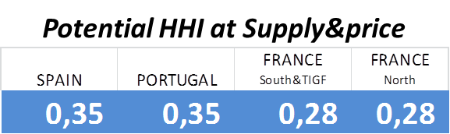
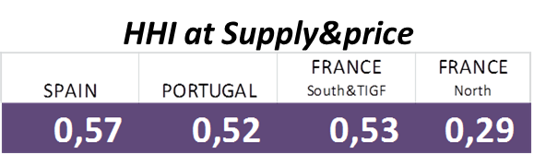
GRIP South – Assessments
Key conclusions
Resilience assessment:
Sufficient capacity for a complete supply/demand balance
Key role of UGS and LGN for short term flexibility and security of supply
The lack of resilience to low LNG deliverability detected in the TYNDP for the Iberian Peninsula is not the facto a risk of security of supply for Spain (high level of LNG diversification by country origin)
Portugal could also improve this issue promoting the LNG diversification.
Supply Source Dependence
High dependence on LNG in the South of France and Iberian Peninsula causes strong price peaks, but not security of supply risk
*
*
Potential evolution after developing the new corridor “Bidirectional flows between Portugal, Spain, France and Germany”
* grouping the supply sources by correlated prices

Slide 43
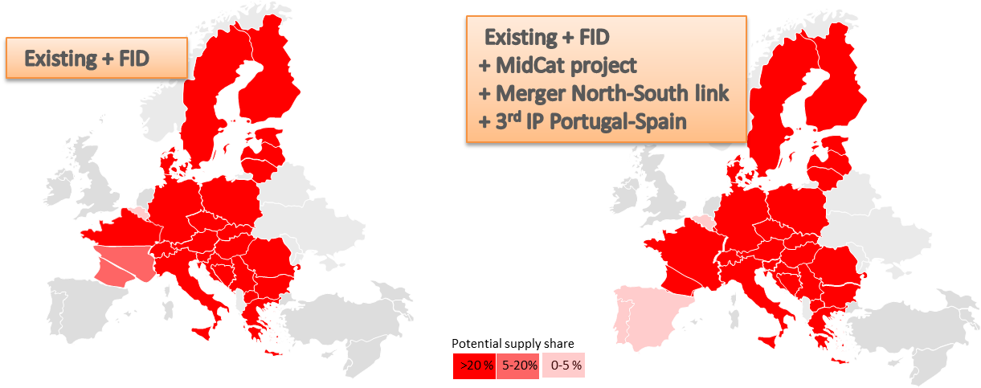
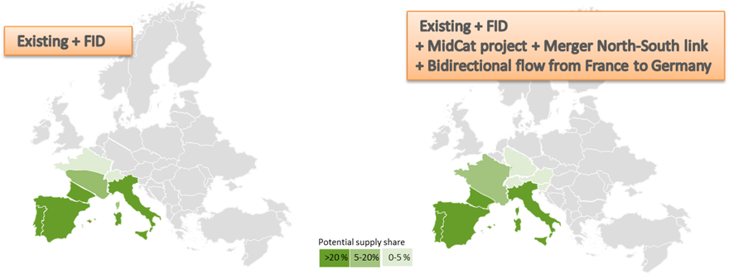
GRIP South – Assessments
Key conclusions
Network adaptability to supply evolution
Identified remedies would create new routes to and from the South, contributing to the optimization of shippers’ supply portfolios, consolidating a well-meshed network, improving the robustness of the gas network.
The identified remedies would improve competitiveness for the industry and the rest of the end consumers of the gas system having a clear positive impact in the economy of the respective countries.

Slide 44
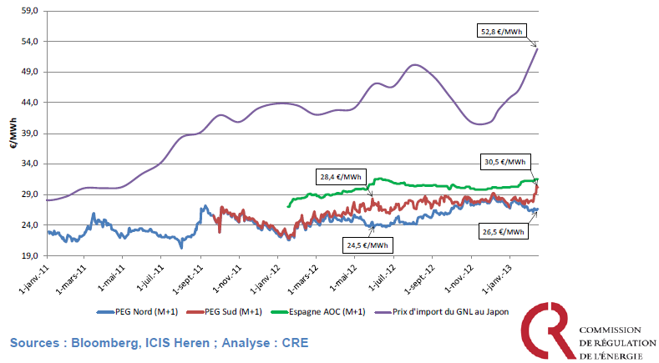
GRIP South – Assessments
Key conclusions
Strong divergences of prices :
Lasting spreads between PEG SUD and Spanish AOC, between PEG NORD and PEG SUD
Lack of ability to face very different supply mixes,
In particular, limited ability to decrease LNG supplies

Slide 45
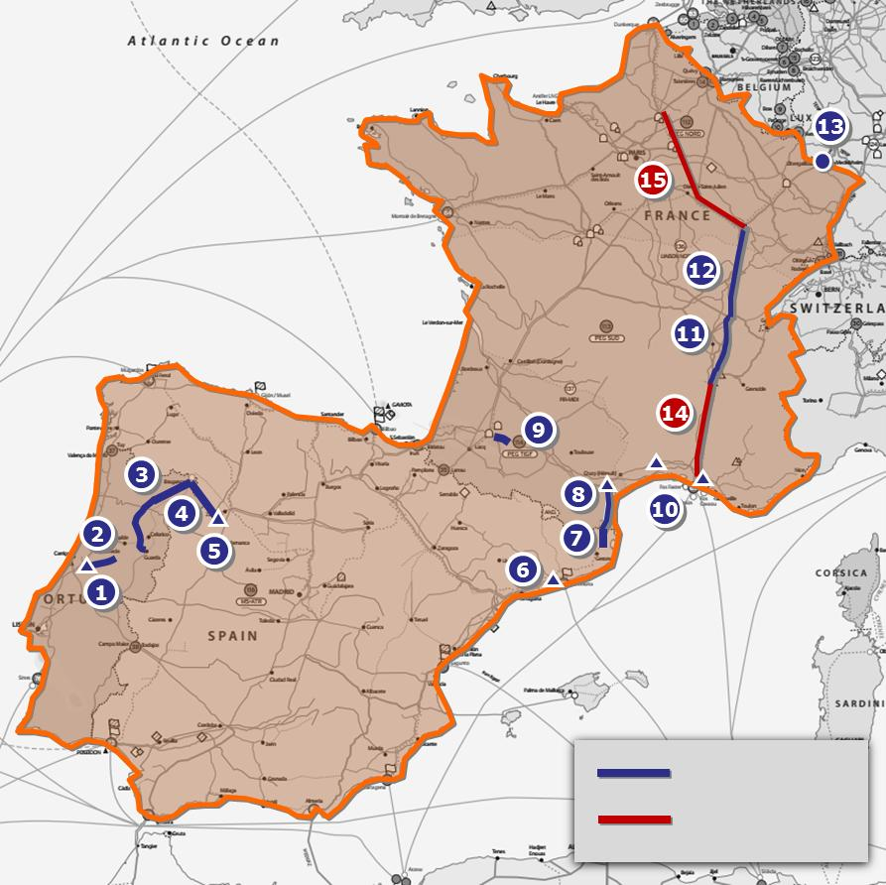
GRIP South – Assessments
Key conclusions
Remedies to divergence of prices
Reduce LNG dependence with bi-directionnal flows between Portugal, Spain, France and Germany with:
3rd IP between Portugal and Spain
MidCat project
Core network reinforcement in France (merger)
Reverse flow from France to Germany

Slide 46
Main conclusions
Economic crisis and competition of energies in the World lead to a decrease in gas consumption in Europe.
As forecasts for gas imports for Europe remain high, South Region could be a main for Algerian gas and LNG. High dependence on LNG should be reduced if more Russian and Norwegian gas could reach southern markets.
A lot of transmission, LGN and storages projects identified. Some of them FID, that will increase interconnection capacities within South Region and with the rest of Europe,
Assessment & remedies: existing system and FID projects not sufficient to face different supply mixes and to create price convergence. The corridor “Bidirectionnal flows between Portugal, Spain, France and Germany” is one of the identified remedy to these issues.
Investments needed are significant. Clear energy policies and support from authorities will be needed in order to secure the cost effectiveness of these investments for the market.

Slide 47
Planning
  ENTSOG TYNDP publication : 21st February 2013
  Communication / consultation
    Continuous and extensive consultation for identifying and updating projects and needs
    GRI South meeting(s): IG & SG meetings (6)
    Public consultation from December 12th to January 5th
    Regulators: “Draft GRIP” shared on December 20^{th,} opinion received on January 31st
    Feedbacks after publication
  Publication & consultation: March 21st
    Simulations updating demand and projects using NeMo tool remain in line with TYNDP 2013
    GRIP finalized with latest feedbacks from NRAs and data updates
    6 weeks for the editing process
47

Slide 48
Thank you for your attention

Slide 49
Thank you for your attention!
21st SG meeting
19th February 2014

